Slide 1
Computer Architecture, 2021 OS, Linux, GNU & user interfaces
Dr. Gylfi Þór Guðmundsson
T-107-TOLH

Slide 2
OS, Linux and The Shell
Apps
Kernel
CPU
RAM
I/O
What is an operating system?
What is Linux?
What is a Text User Interface (TUI)
A.k.a. a shell, a.k.a. a terminal

Slide 3
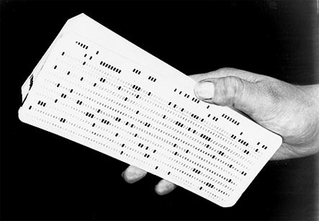
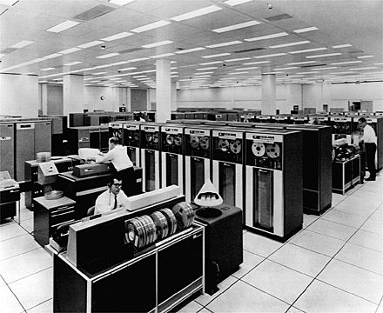
Before Operating Systems
Programming was a slow process
Punched cards were the input
No computer in sight
Punched cards were sent to a mainframe where they were processed in batches
Only one program could run at the time

Slide 4
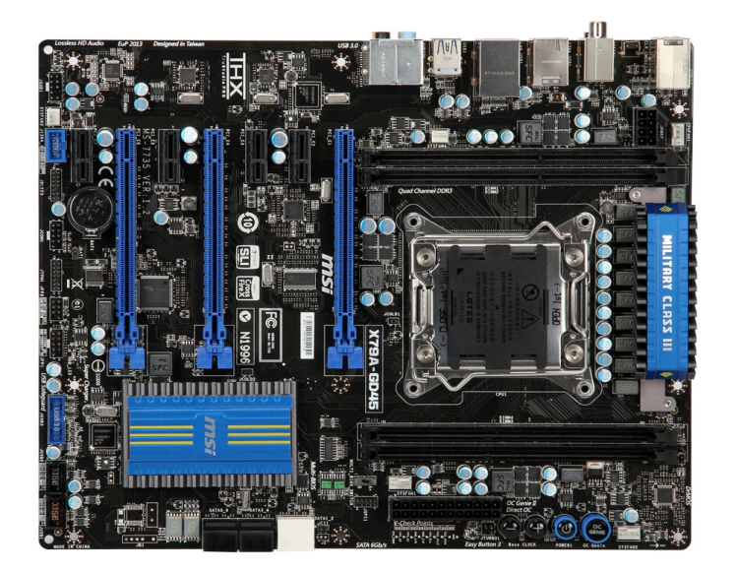
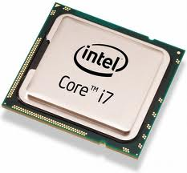
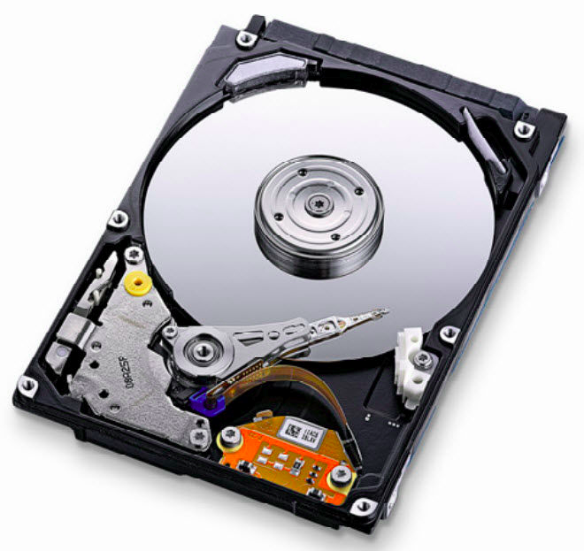
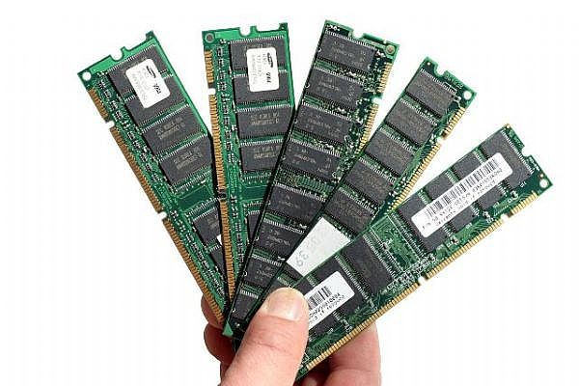
The Operating System
The OS bridges the gap between the software (humans)
and the hardware (the machine).
The core of the OS is the Kernel It, like the rest of the OS, is actually software.
Applications
What the user sees
Kernel
The hidden manager
CPU
Memory
Devices
The resources

Slide 5
Kernel
The kernel:
Handles the “resource management” of the hardware.
Most kernels allow multi-user and programs in parallel:
Scheduling allows multiple programs at the same time
Time sharing allows multiple users at the same time
Kernel
The hidden manager
CPU
Memory
Devices

Slide 6
OS utilities
The rest of the OS is software to assist the users
The first computers had no screen, just lights and print-out
TUI, or Text User Interface, came with the screen & keyborad
GUI, or Graphical User Inteface, came later
We will learn to use the command line (TUI) and we will connect to it via Secure Shell or SSH
Applications
What the user sees

Slide 7
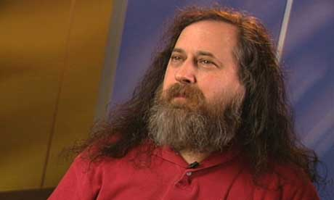
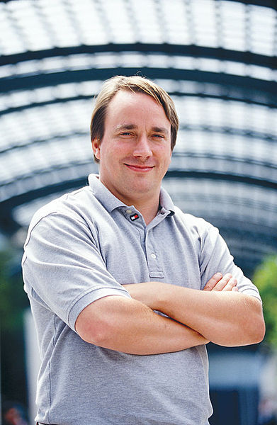


The story of Linux
In the beginning..
Bell Labs Unix (by Thompson & Richie)
Stallman’s GNU project
Thorvald’s per kernel project
Linux OS

Slide 8
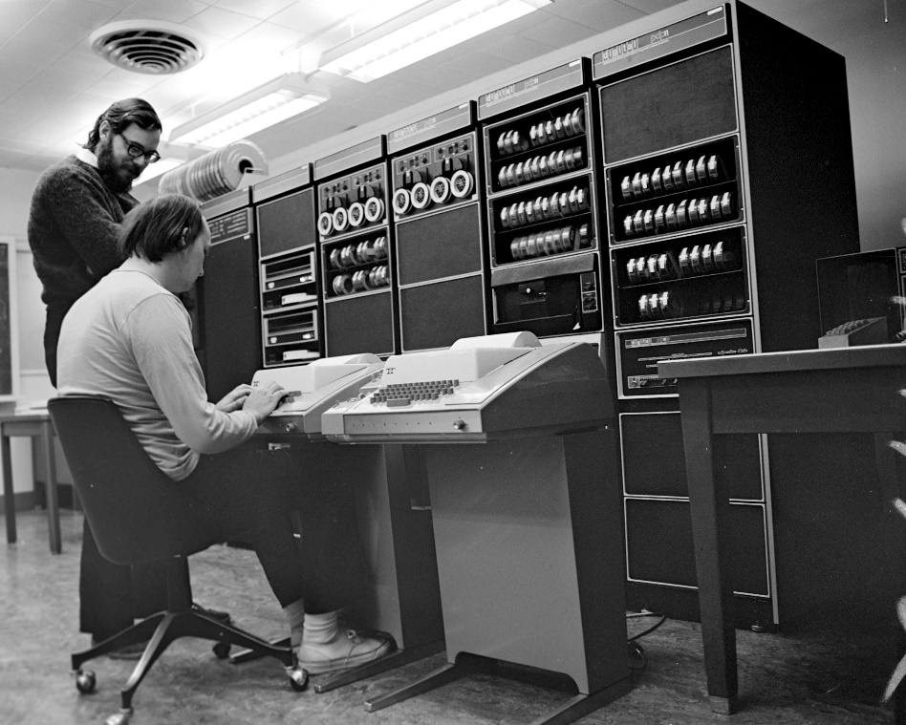
Unix
Created at Bell Laboratories by Ken Thompson & Dennis Ritchie
Unix is an OS for “small computers”
First written in assembly for DEC’s PDP-11 in 1969
The PDP-11 was a16 bit minicomputer
Unix was ported to C in 1972
Used in Universities (BSD and System V)
Became the most successful OS of its time

Slide 9
UNIX – Multi-tasking and Multi-user OS
The structure of AT&T’s UNIX
Tools & Apps
Shell
Kernel
Written in C – Highly portable to different hardware
But it was not free

Slide 10

GNU – GNU is not Unix
Started by Richard M. Stallman
Project started at MIT in 1978
Open contribution in 1983
Everything but a kernel by 1990
Aimed to create a complete free operating system: “GNU Licence” (Free as in free-speach)

Slide 11
Linux – Create by Linus Thorvalds in 1991
Linus was a student that got tired of MINIX
So he wrote his own kernel http://www.thelinuxdaily.com/2010/04/the-first-linux-announcement-from-linus-torvalds/ https://www.youtube.com/watch?v=5ocq6_3-nEw
Linux is:
Only a kernel
Based on Unix, realeased under GNU
Portability and hardware support
Runs on most architectures
Scalable
Compliance to standards and interoperability
Open Source
Free Software
https://www.youtube.com/watch?v=yVpbFMhOAwE

Slide 12
Linux & Linux OS’s
Linux is just the kernel
Open Source
Free Software
All Linux OS’s use tools from GNU
Linux is based on Unix
Unix was created at Bell Labratories in 1969
GNU Project was started 1983* and was ready with everything but a kernel in 1990
Linux was created by Linus Thorvalds in 1991
GNU Shell
GNU Tools & Apps
Linux
Kernel

Slide 13

Many different Linux distributions
Open source gives you full flexibility

Slide 14
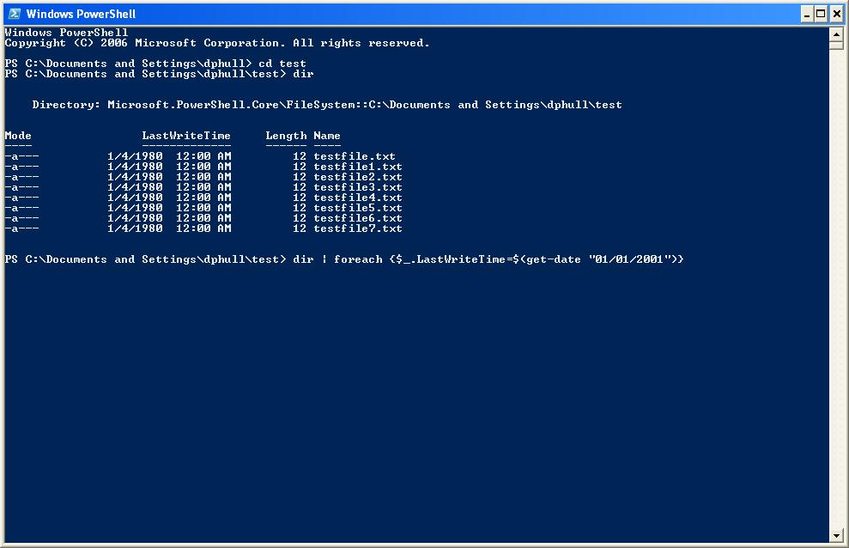
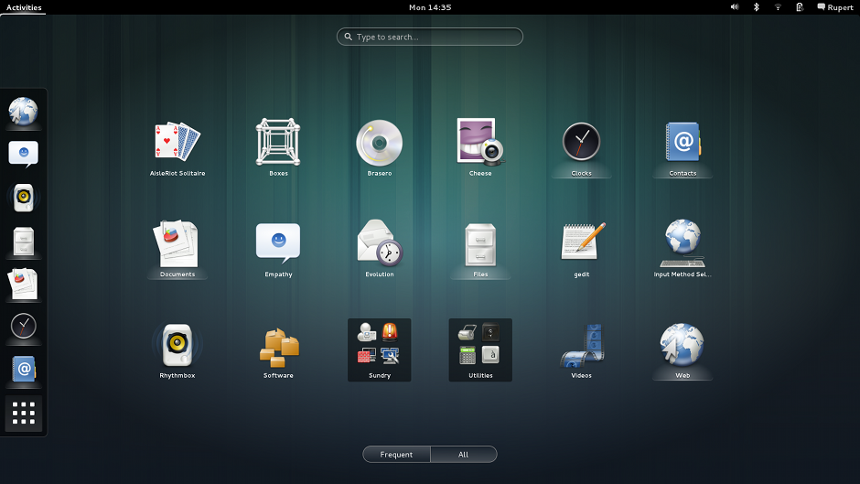
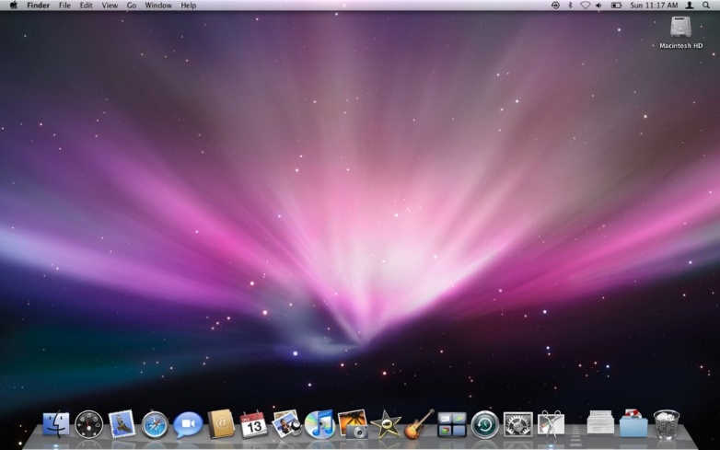
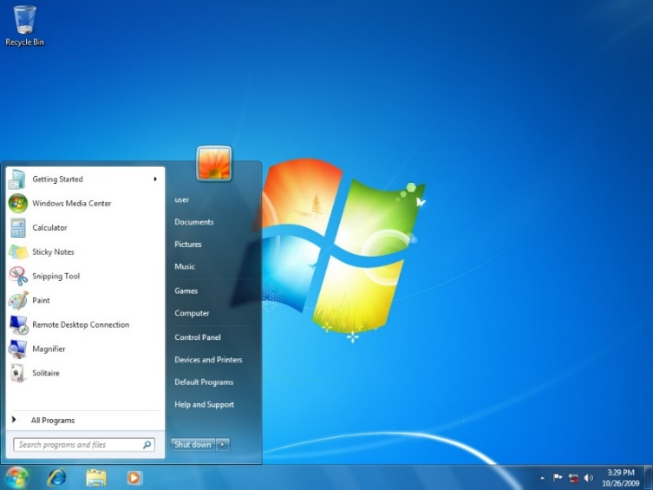
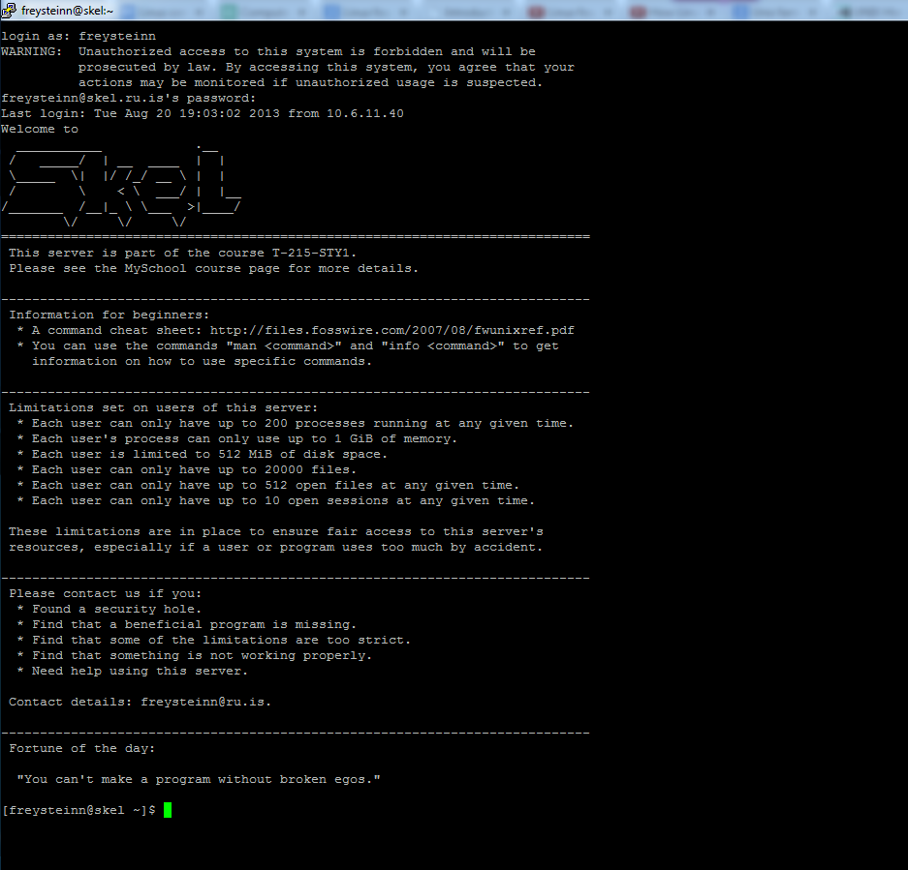
User Interface
What is a shell
TUI vs. GUI
Secure Shell (SSH)

Slide 15
What is a shell?

Slide 16
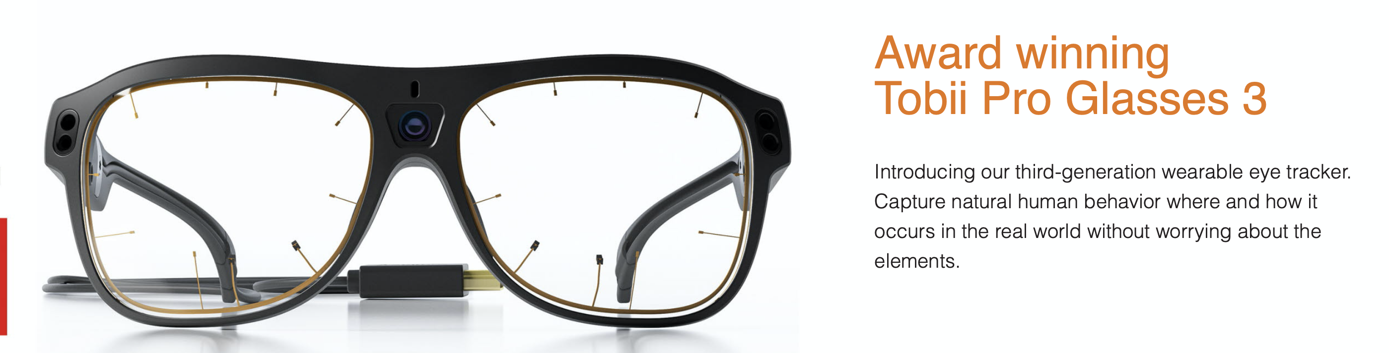
A Shell is just a program
The shell program reads input from the users:
Keystrokes on keyboard.
Mouse movement and clicks.
Or even Eye-tracking with camera sensors.
The logic of a command line shell is fairly simple:
Read input from the user.
Find the program & run it, else print an error msg.
And finally do the clean up when the program exits.
A common project in Operating Systems courses is to have students write a simple command line shell program.
https://www.tobiipro.com

Slide 17
Shells: TUI vs GUI
TUI – Text User Interface
Everything you see is based on text
Visual interfaces is still possible
Simple but powerfull commands
Great flexibility in chaning many simple commands
Automating tasks is easy via scripting
Simple operations can be tedious
Less intuative as there are less visual aid

Slide 18
Shells: TUI vs GUI
GUI – Graphical User Interface
Everything you see is graphical
Visual navigation & “point and click” to run commands
Powerful graphical representations that give visual aid
Hard to do complex operations
Programs tend to be larger and more complex
Less flexibility if functionality not provided in GUI

Slide 19
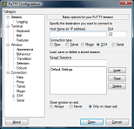
Secure Shell (SSH)
Windows:
Can use ssh command in the cmd shell
Recommend using Putty (https://putty.org)
Linux and Mac OS:
Use the ssh program from a TUI terminal
The command line syntax for ssh
ssh “username”@server

Slide 20
Copying files via SSH
Windows:
Putty includes a tool called PSCP
GUI clients are also available, like WinSCP
http://winscp.net
Linux and Mac OS:
Use the scp program from a TUI terminal
Works like cp but you can say
scp username@server:/path/to/file ./
So it is similar to ssh, but you put PATHs after the colon ’:’

Slide 21
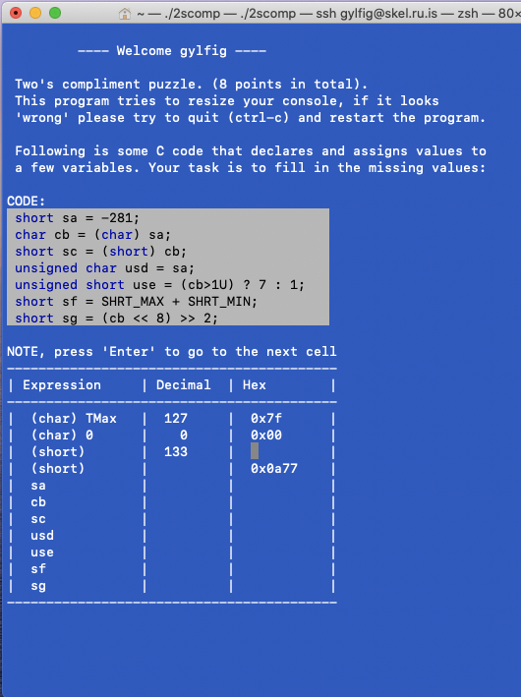
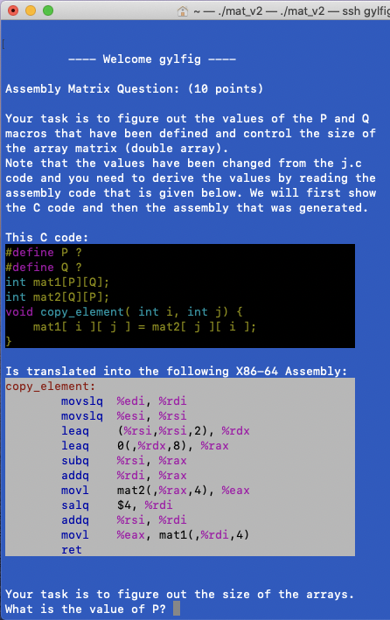
Examples of ”Graphical” TUI
The home exam in this course last year:
Several questions were programs written in C.
Fill in forms with input validation.
Code that is generated but still show color coded.
3 week course is to write a command line program
In the last 2 years I have seen very nice graphical TUI interfaces from students.

